Slide 1
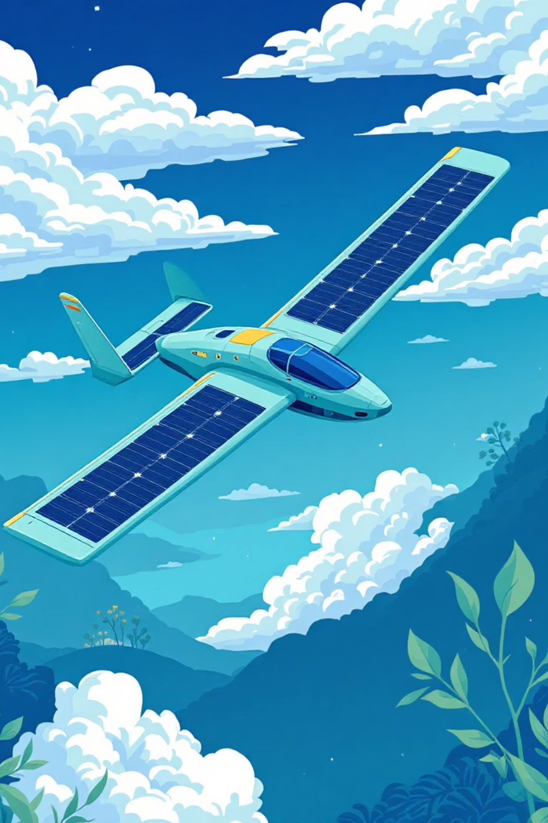

Solar-Powered UAVs: Engineering Approaches to Achieve Longer Flight Duration
Student URN: 6938894
University of Surrey

Slide 2
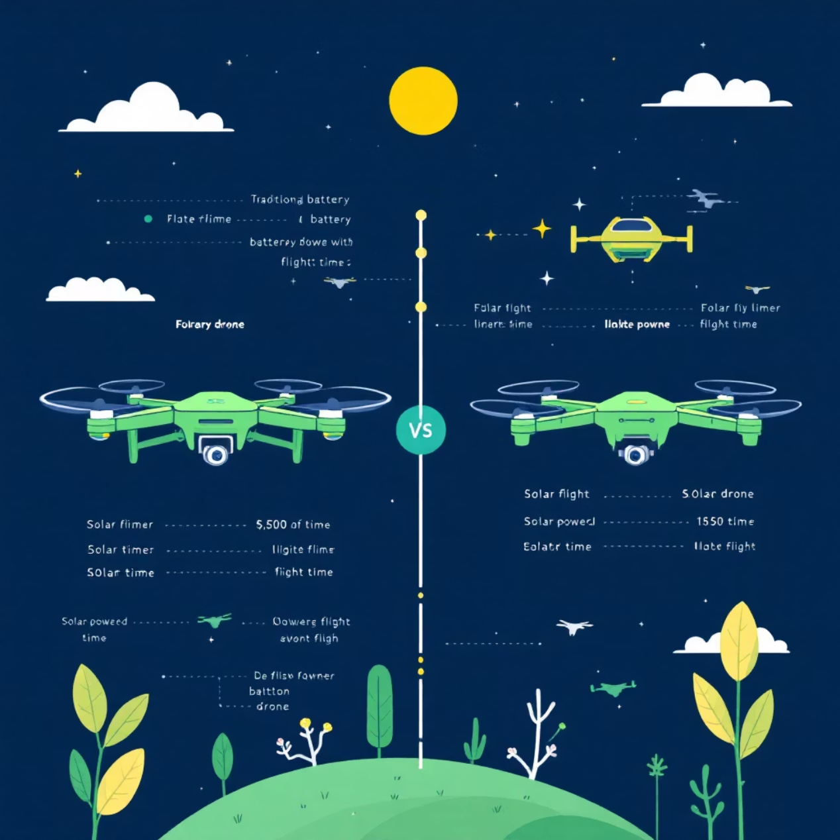
Why Solar-Powered UAVs?
UAVs used in monitoring, emergency response & communication
Short battery life limits flight duration
Solar UAVs generate energy during flight
PV cells can power motors or charge batteries
Enables longer missions and continuous operation
Supported by research (El-Atab et al., 2021; Sornek et al., 2025)

Slide 3






Energy Systems & Optimisation Methods
PV cells generate power + charge batteries
Power management balances propulsion & avionics
“Climb by day, glide by night” strategy (Gao et al., 2023)
Optimisation improves aircraft geometry
Genetic algorithms used for endurance
MDAO links aerodynamics, structure & energy (Li et al., 2020)

Slide 4






Energy Systems & Optimisation Methods
PV cells generate power + charge batteries
Power management balances propulsion & avionics
“Climb by day, glide by night” strategy (Gao et al., 2023)
Optimisation improves aircraft geometry
Genetic algorithms used for endurance
MDAO links aerodynamics, structure & energy (Li et al., 2020)

Slide 5
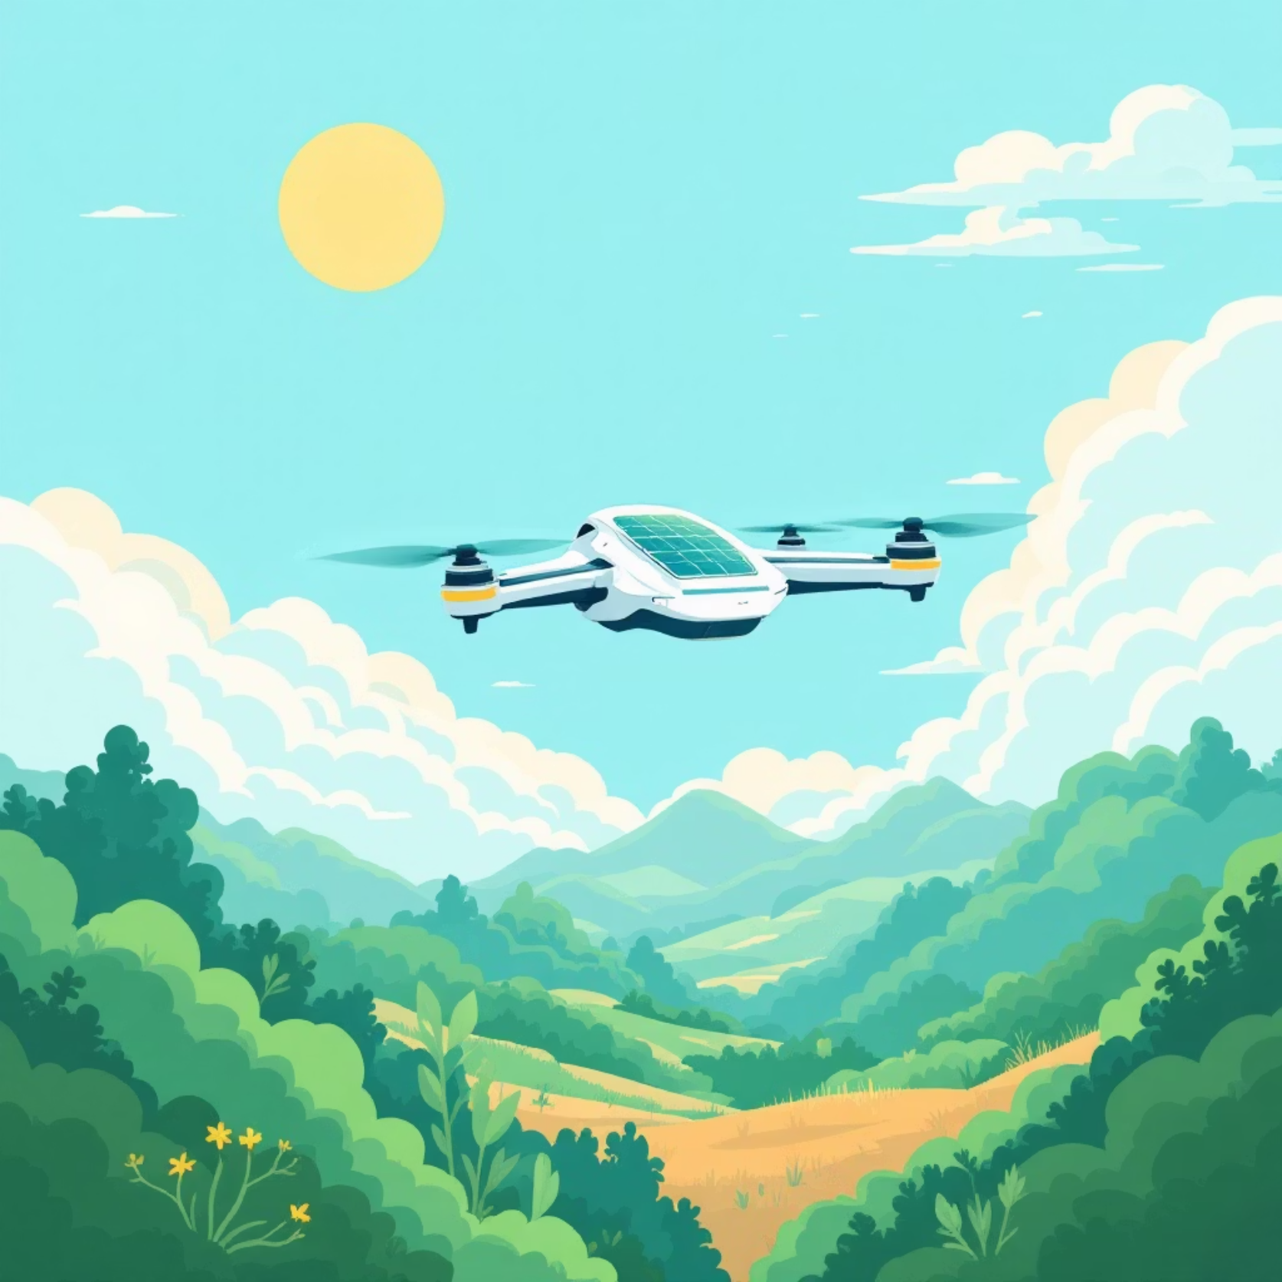
Conclusion
Solar UAVs overcome battery limitations
Efficient wings + lightweight materials improve endurance
Intelligent energy management extends flight time
Strong potential for long, continuous missions
Useful for environmental monitoring & remote communication
Sustainable future for UAV design

